Slide 1














REGIONAL CLUSTERING BASED ON INCIDENCE
POVERTY
SALMA AZMI RASYIDAH

Slide 2



INTRODUCTION
Source
OFFICIAL DATA FROM BPS EAST JAVA (BPS.JATIM.GO.ID)
Tools
RSTUDIO

Slide 3


TYPE OF DATA
POVERTY INDICATORS
Percentage of Poor Population
Poverty Line
P1
(Poverty Depth Index)
P2
(Poverty Severity Index)

Slide 4

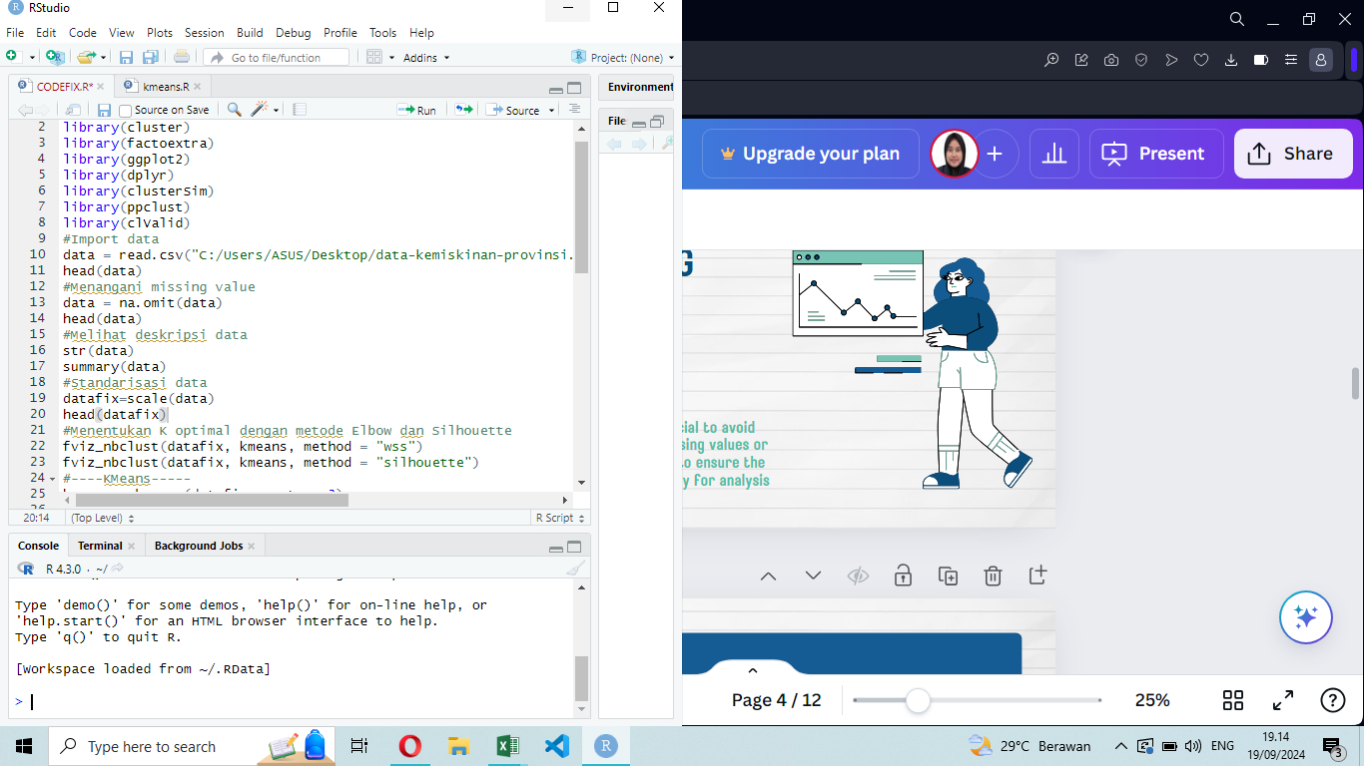
DATA CLEANING
Handling missing data is crucial to avoid biased results. We fill in missing values or remove incomplete records to ensure the dataset is accurate and ready for analysis

Slide 5
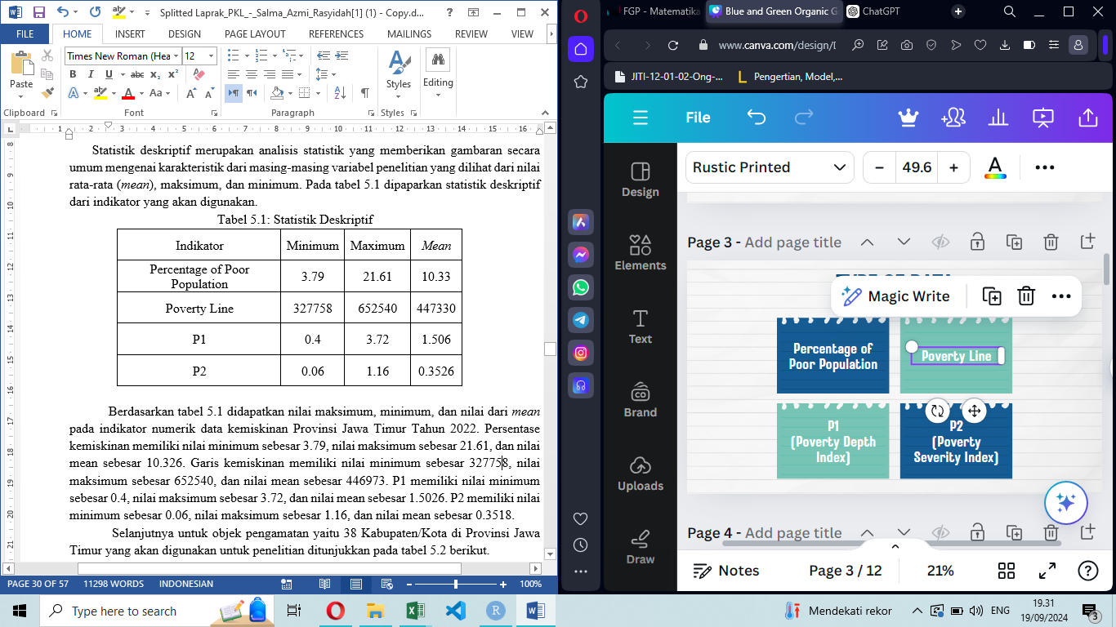
DESCRIPTIVE STATISTICS
Summarizing the data with key metrics like minimum, maxsimum, and mean to understand its basic characteristics.

Slide 6

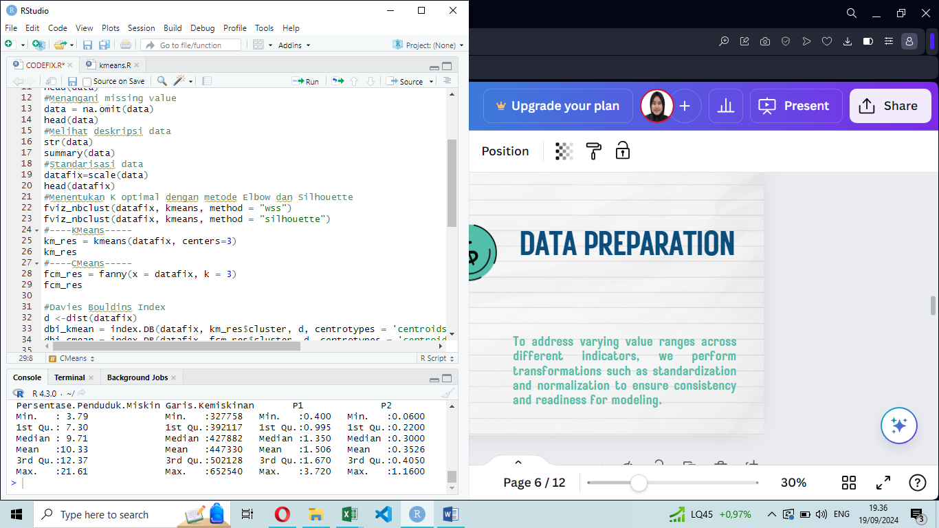
DATA PREPARATION
To address varying value ranges across different indicators, we perform transformations such as standardization and normalization to ensure consistency and readiness for modeling.

Slide 7
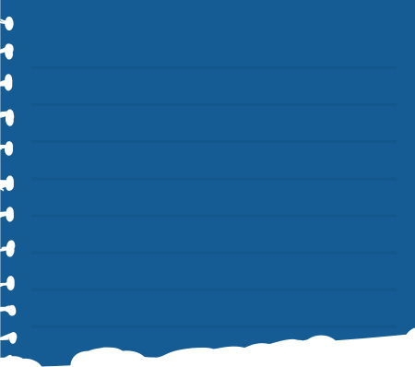

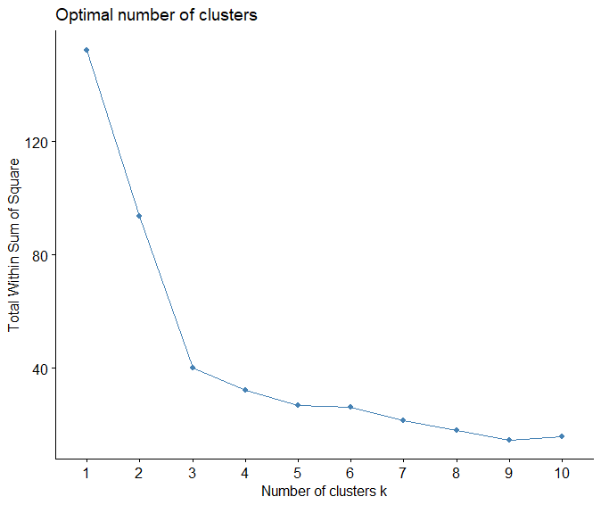
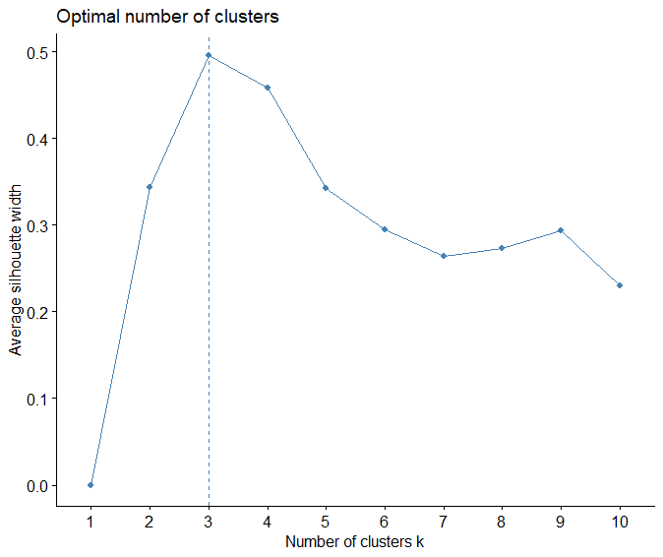
DETERMINING OPTIMAL K: ELBOW AND SILHOUETTE METHODS
ELBOW (K=3)
SILHOUETTE (K=3)

Slide 8
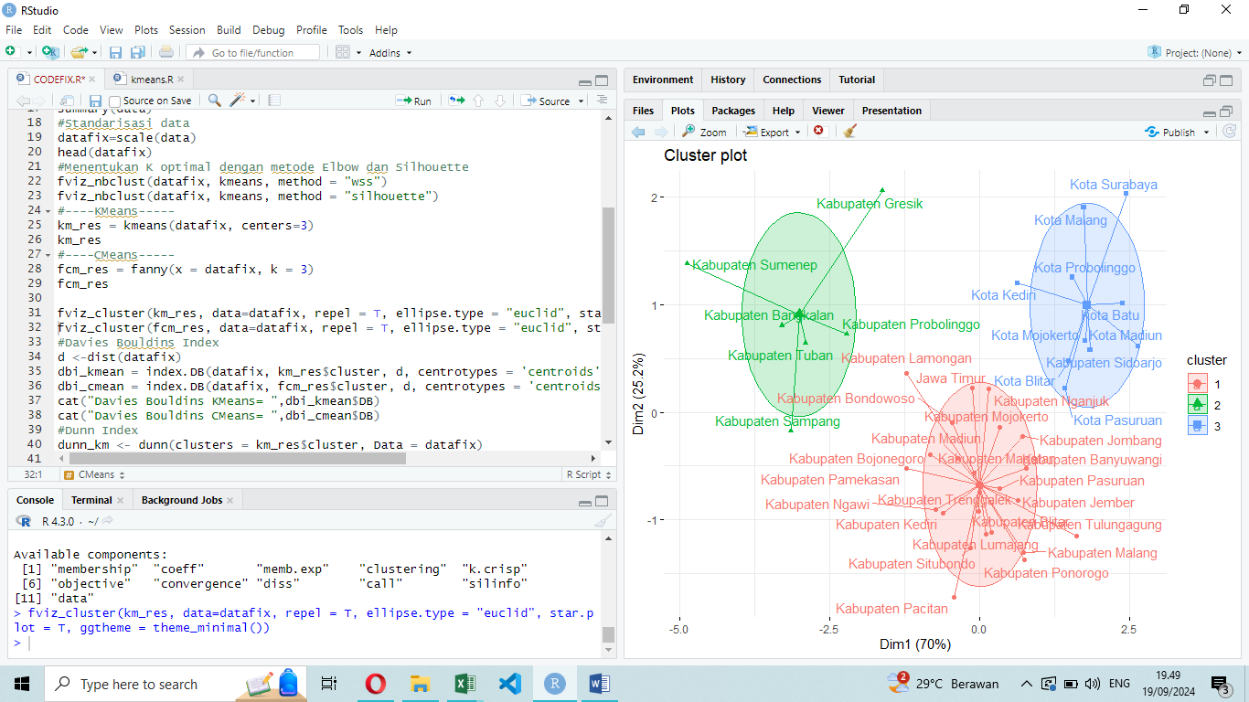
DATA MODELING
K-MEANS
FUZZY C-MEANS
Divides data into K clusters by minimizing the variance within each cluster around the centroids
Assigns data to multiple clusters with varying degrees

Slide 9
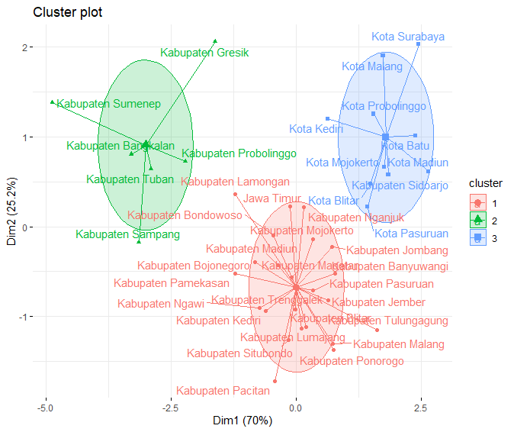
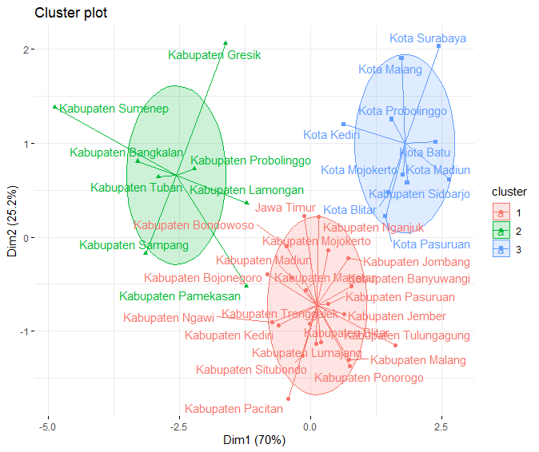
VISUALIZATION OF CLUSTERING RESULTS
K-MEANS
FUZZY C-MEANS

Slide 10
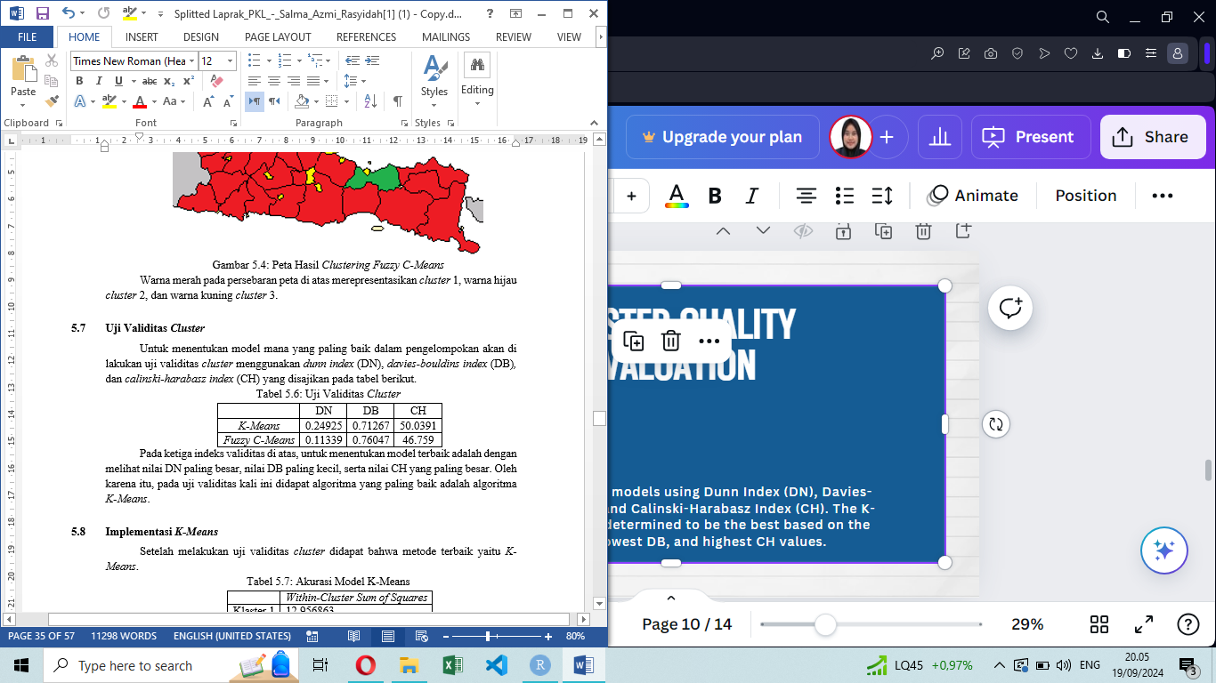
CLUSTER QUALITY EVALUATION
Assessing clustering models using Dunn Index (DN), Davies-Bouldin Index (DB), and Calinski-Harabasz Index (CH). The K-Means algorithm is determined to be the best based on the highest DN, lowest DB, and highest CH values.

Slide 11
THANK YOU VERY MUCH!

